Slide 1

Assist Management Consultancy
Training on QMS
Facilitated by
Brig Gen Mofiz (R ) &
Md. Kaiser Hamid

Slide 2
Introduction of the Assist Personnel

Slide 3

Brig General M Mofizur Rahman, psc, P Eng (R) mofiz373@gmail.com , +88 01613 02 39 39
Consultant/Lead Auditor/Trainer on:
Career Pattern:
Faulty BRACU BRAC Business School MSC 725 Quality Management & Control (TQM)
Academic Council Member of DIU (Daffodil Int. University)
Founder Commandant of MIST (Military Institute of Science & Technology) Mirpur
Former Executive Chairman BEPZA (Bangladesh EPZ Authority)
Former MD DESCO (Dhaka Electric Supply Co Ltd)
Former MD WZPDCL (West Zone Power Distribution Co Ltd, Khulna)
Former Chief Engineer & D Works, Bangladesh Army (1969 – 2001: 31 yrs)
Member of professional & Social Associations: IEB, BSTQM, BAAS, APO Society for BD, BEA, ASCE (USA) and socially a Rotarian & member of KGC & DCL
ISO 9001 | ISO 14001
OHSAS 18001 | ISO/IEC 17025
ISO 17065 | ISO 17021
TQM | CSR
Academic: MBA | MDS
B Sc Engg (civil) | DSC

Slide 4

MD.KAISER HAMID
kaiser.hr00.com , +88 01672 42 06 00
Consultant/Lead Auditor/Trainer on:
ISO 9001:2008 (Quality Management System) Lead Auditor
ISO 14001:2004 (Environmental Management System) Consultant
OHSAS 18001: 2007 Occupational Health & Safety(OHS) Consultant
Human Resource Management (HRM) Consultant
Social Compliance – Consultant
Consultant Org :
Rural Electrification Board of Bangladesh
GIZ – OHS Assessment
Volvo Battery
Mama Noodles - Thai President Foods Public Company Limited
Corny Group
Asrotex Group
Anguman Garment
King Kong Leather Ltd.
Master Simex Ltd
Sky Apparel Ltd
Previous Employer :
Asst. Manager- Bay City GmbH- (Germanys Brand)
Coordinator-TAKKO Holding GmbH – (Germanys Brand)
Asst. Manager- Maruhisa Pacific co Ltd (Japanese)

Slide 5
Introduction of the participants:
Name
Designation & Organization
Education and Past Job Experience
Expectations from this training course
Hobbies
Any other interesting point

Slide 6
KIND ATTENTION TO THE FOLLOWING POINTS
Interactive Session
Specific question any time
General questions during Q&A Session
Mobile in silent mode
Medium of instruction / slides: Bangla & English
Concise language used in slides with abbreviations
Non-decorative professional slides
Safety Rules to be followed
Suggestions & observations are welcome
Highlight/ Different Colour fonts in slides
Slides will not be readout
Please sign Attendance Sheet preferably with name, official designation, mob, e-mail etc
If you have any special requirements inform the tutor(s).

Slide 7
PHASES OF APPRAISAL
Day - 1
Introduction to ISO
QMS Principal
Benefit of ISO 9001: 2008
ISO 9001: 2008 Clause
Workshop -1
Workshop -2

Slide 8
PHASES OF APPRAISAL
Day - 2
Introduction to Auditing
Terms and Definitions
Internal Audit Requirements
Principles of Auditing
Auditor’s role, responsibility and attitude
Audit Plan and Programme
Conducting the Audit
Follow up activities including evaluation of corrective action.
Certification Audit
Evaluation

Slide 9


Background of ISO Standards:
= International Organization for Standardization
Why not IOS
ISO is a worldwide federation of national standards bodies.

Slide 10

Background of ISO Standards:
ISO = International Organization for Standardization
Why not IOS ?
Because of different acronyms in different languages:
IOS in English, OIN in French for Organisation internationale de normalisation.
ISO is derived from the Greek isos, meaning equal. Whatever the country, whatever the language, the short form of our name is always ISO.

Slide 11
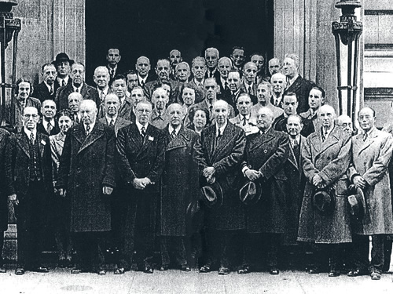
Background of ISO Standards:
In London, in 1946,
65 delegates from 25 countries meet to discuss the future of International Standardization. In 1947, ISO officially comes into existence.

Slide 12
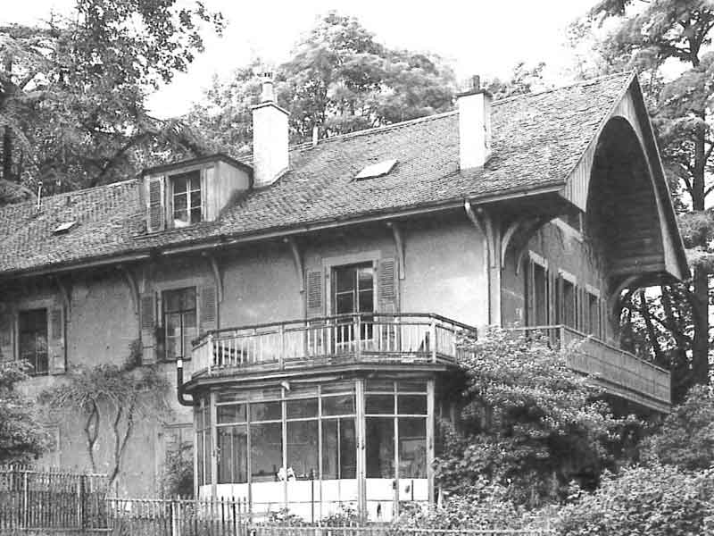
Background of ISO Standards:
In 1949,
ISO moves into offices in a small, private house in Geneva. In the early 1950s the Central Secretariat has 5 members of staff.

Slide 13
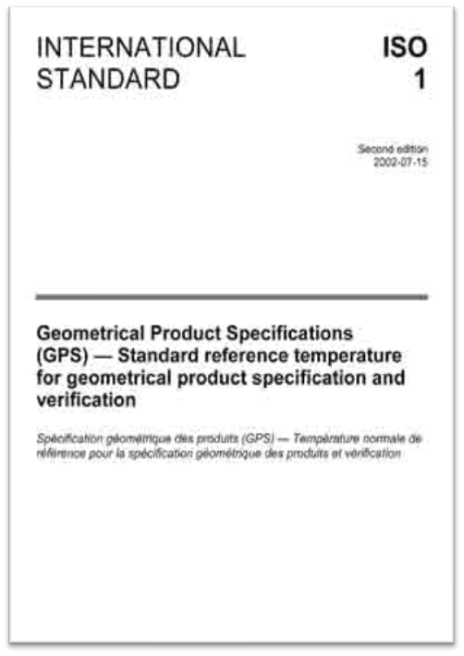
Background of ISO Standards:
In 1951,
the first ISO standard (called Recommendations at this time), ISO/R 1:1951Standard reference temperature for industrial length measurements, is published.

Slide 14

Background of ISO Standards:
ISO 9000 family
In 1987, ISO publishes its first quality management standard.
Standards in the ISO 9000 family have gone on to become some of the most well known and best selling standards.
Quality management standards are often used by manufacturers to reassure
consumers that products are of high quality

Slide 15

Background of ISO Standards:
ISO's new offices
In 2007, ISO moves to its current offices in La Voie Creuse, Geneva.
Today the Central Secretariat employs almost 150 people, a significant increase from the staff of 5 in the early 1950s.

Slide 16
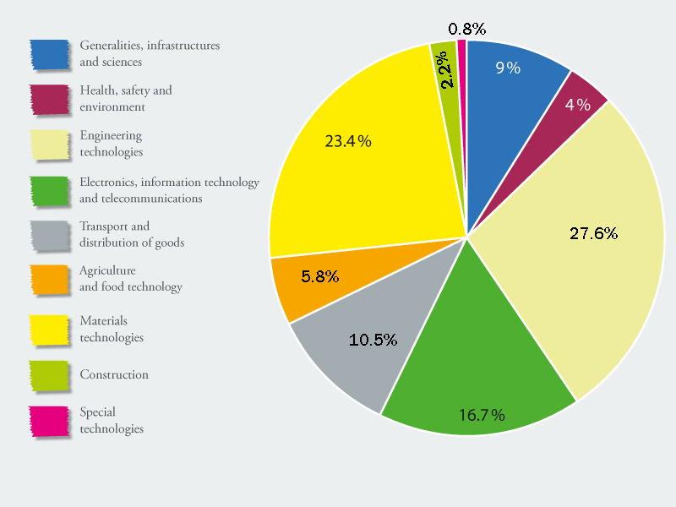
Background of ISO Standards:
ISO Today
At the start of 2012, ISO has 163 members and has a total of over 19 000 standards.
Today, ISO International Standards cover almost all aspects of technology and business.
ISO Video: 2 minutes

Slide 17
Background of ISO Standards:
ISO Today
At the start of 2012, ISO has 163 members and has a total of over 19 000 standards.
Today, ISO International Standards cover almost all aspects of technology and business.
ISO Video: 2 minutes

Slide 18
The ISO 9001:2008 Standard
1. What is quality?
Quality: Fitness for intended use.
Quality: degree to which a set of inherent characteristics fulfils requirements (Clause 3.1.1 of ISO 9000)
2. What is Quality Management System (QMS)?
QMS: management system to direct and control an organization with regard to quality (3.2.3)
3. What is Process ?
Process: set of interrelated or interacting activities which transforms inputs into outputs (3.4.1)

Slide 19
Defining Quality – 5 Ways
Conformance to specifications
  Does product/service meet targets and tolerances defined by designers? (producer end)
Fitness for use
  Evaluates performance for intended use (customer end)
Value for price paid
  Evaluation of usefulness vs. price paid
Support services
  Quality of support - after sales service
Psychological
  e.g. Ambiance, prestige, friendly staff

Slide 20
The ISO 9000 Family of Standards
  ISO 9000: 2005 QMS Fundamental & Vocabulary
  ISO 9001: 2008 QMS Requirement
  ISO 9004: 2009 Guidance (Managing for the sustained success of an org – a QM Approach)
  ISO 19011: 2002 Guidelines for Auditing

Slide 21

QUALITY MANAGEMENT SYSTEM PRINCIPLES
Customer Focus
Leadership
Involvement of the people.
Process Approach
System Approach to Management
Continual Improvement
Factual Approach to Decision Making
Mutually Beneficial Supplier Relationships
Notes:
Customer focus mean their requirements are consistently meet and effort are given to exceed their requirements. Leadership establish unity of purpose and direction of organization to meet business objectives also ensure everybody involvement for the same purpose. For an organization to function effectively, management has to identify and co-ordinate numerous linked activities. An activity that takes “input” and converts them to output can be considered as process. Very often the output from one process is input to another process. The effectiveness and efficiency of an organization is improved by identifying, understanding and managing a system of interrelated processes, needed to achieve the objectives. example is triple role of ISO. This is exactly what ISO is required.
This General Requirements sets the stage for the standard. It paints with a broad brush what is expected of the system
Note the update when necessary clauses
Note the outsourced processes with food safety implications need to be managed within the FSMS

Slide 22
QMS requirement as per ISO 9001: 2008
  Legal Requirement
  All requirements as stated in 8 main & related sub clauses of ISO 9001: 2008
  Requirements as per organization's own procedures, policies & instructions
  Any agreement with buyers, stakeholders, interested parties (compliance)

Slide 23
Advantages of Implementing QMS as per ISO 9001: 2008 S 1 / 5
(All clauses mentioned within brackets ref to ISO 9001: 2008)
Legal Requirement ISO 9001 is the Mother Standard of QMS and the most basic standard of ISO’s 19000+ standards. It’s a generic standards.
First Impression is the last impression. A organization is more acceptable both nationally & internationally if certified as per ISO 9001: 2008.
QMS (SSO 9000 series) gives max emphasis on three issues:
  Customers’ requirements including both internal and external customers.(5.2, 7.2.3 & 8.2.1)
  Continual improvement which is must to survive in this dynamic and competitive world. (8.5.1)
  Communication both within the organization and outside including all stakeholders. (5.5.3 & 7.2.3)

Slide 24
Advantages of Implementing QMS as per ISO 9001: 2008 S 2 / 5
It gives greater leadership development scope. (5.1, 5.3, 5.5.1, 5.6)
It ensures HRD Development. “Man behind the machine” has always been important. It makes all individual conscious of their activities as how their activities affect quality/output and conscious about the mission / vision / top management policy. (6.2.2 & 5.3)
It ensures setting appropriate Quality Policy and SMART Objectives leading to effective planning and efficient output and outcome. (5.3, 5.4.1, 5.4.2)

Slide 25
Advantages of Implementing QMS as per ISO 9001: 2008 S 3 / 5
It ensures better work environment leading to governance (transparency & accountability) and ensuring ergonomic (OHS: Occupational Health & safety issues and EMS (Environmental Management System). (6.4)
Higher customer satisfaction levels and improved customer perception. (Survey Data)
The organization gets the benefits of free R&D output on management techniques by global Management Gurus without any investment. (continually updated versions).
It reduces ambiguity in management and administration by following control of documentation and control of records following laid down Policy / Objectives / Planning / SOP / Work Instructions. (4.2.3, 4.2.4 , 5.3)

Slide 26
Advantages of Implementing QMS as per ISO 9001: 2008 S 4 / 5
It ensures productivity, profit , better services and reduces operating cost etc.
It converts an organization from reactive to proactive following Data Analysis, Preventive & Corrective actions.
It’s a very flexible system recognizing the existing organizational culture, practices & SOPs. During 3rd party independent audit, it looks for:
    Legal requirement of the Govt
    QMS Requirements as per ISO 9000 series
    Organizations’ own practices & SOPs
    Compliance as per MOU, agreement, understanding with the stakeholders.

Slide 27
Advantages of Implementing QMS as per ISO 9001: 2008 S 5 / 5
It brings a paradigm shift / attitudinal change to the personnel of an organization in terms of customers’ (both internal & external) requirements, quality impact of one’s activities and continual improvement. (Survey Results)
Besides organizational advantages, QMS also gives personal benefits in terms of individual, family, domestic & official efficient & effective management.(1.2)
It gives confidence of following an internationally acclaimed standard.

Slide 28
Plan-Do-Check-Act cycle & continual improvement
Establish objectives
necessary to deliver results in accordance
with customer requirements
and the organisation's policies
Take actions to continually
improve process performance –
effectiveness and efficiency
Plan
Act
What to do
How to do it
How to improve next time?
Check
Do
Do what was planned
Did things happen according to plan?
Monitor and measure
processes and product
against policies, objectives
and requirements
Implement the processes
Notes:
The process approach is therefore, is the systematic identification and management of these activities and the interaction between the activities.
Effectively and efficiency of an organization is improved through identification, understanding and managing a system of interrelated processes needed to achieve objectives.

Slide 29
PDCA / DEMING CYCLE
P4
P3
P2
P1
P : Plan
D : Do
C : Check
A : Action
A3
C 3
C 2
C 1
A2
D3
A1
P
D
D2
A
C
D1

Slide 30
KAIZEN/Continual Improvement
Innovation / Invention
TIME
IMPROVEMENT
TIME

Slide 31


Slide 32
QMS – ISO9001:2008
Clause by Clause Requirements and Document Control

Slide 33
ISO 9001:2008 Clauses
Scope
Normative Reference
Terms and Definitions
Quality Management System
Management Responsibility
Resources Management
Product Realization
Measurement, Analysis and Improvement
Notes:
ISO9001 sets out the requirements for a quality management system where an organization-needs to demonstrate the ability to provide consistently, product that meets customer and applicable regulatory requirements. And aim to enhance customer satisfcation

Slide 34
Contents of ISO 9001:2008
CLAUSES |  |  | TOPICS | PAGE
1 |  |  | Scope | 01
2 |  |  | Normative references | 01
3 |  |  | Terms and definitions | 01
4 |  |  | Quality Management System (QMS) | 02
5 |  |  | Management responsibility | 03
6 |  |  | Resource management | 06
7 |  |  | Product realization | 07
8 |  |  | Measurement, analysis and improvement | 12 - 13
Annex A |  |  | Correspondence between ISO 9001:2008 and ISO 14001:2004
Annex B |  |  | Changes between ISO 9001:2000 and ISO 9001:2008
Bibliography

Slide 35
ISO 9001:2008, Clause – 1 Scope
Demonstrate ability to provide product that meets customer requirements
Address customer satisfaction and continual improvement
Generic and application to all types of organizations

Slide 36
Permissible exclusions
ISO 9001 - Scope
Exclusions may be due to:
Nature of the product
Customer requirements
Applicable regulatory requirements
Must be justified Limited to Clause 7 only
May not be requirements which affect the ability to provide product that meets customer and regulatory requirements

Slide 37
Contents of ISO 9001:2008
CLAUSES |  |  | TOPICS | PAGE
1 |  |  | Scope | 01
2 |  |  | Normative references | 01
3 |  |  | Terms and definitions | 01
4 |  |  | Quality Management System (QMS) | 02
5 |  |  | Management responsibility | 03
6 |  |  | Resource management | 06
7 |  |  | Product realization | 07
8 |  |  | Measurement, analysis and improvement | 12 - 13
Annex A |  |  | Correspondence between ISO 9001:2008 and ISO 14001:2004
Annex B |  |  | Changes between ISO 9001:2000 and ISO 9001:2008
Bibliography

Slide 38
Clause 2 Normative Reference
ISO 9000:2005, Quality management systems — Fundamentals and vocabulary

Slide 39
Contents of ISO 9001:2008
CLAUSES |  |  | TOPICS | PAGE
1 |  |  | Scope | 01
2 |  |  | Normative references | 01
3 |  |  | Terms and definitions | 01
4 |  |  | Quality Management System (QMS) | 02
5 |  |  | Management responsibility | 03
6 |  |  | Resource management | 06
7 |  |  | Product realization | 07
8 |  |  | Measurement, analysis and improvement | 12 - 13
Annex A |  |  | Correspondence between ISO 9001:2008 and ISO 14001:2004
Annex B |  |  | Changes between ISO 9001:2000 and ISO 9001:2008
Bibliography

Slide 40
Clause 3 Terms and definitions
For the purposes of this document, the terms and definitions given in ISO 9000 apply.
wherever the term “product” occurs, it can also mean “service”.

Slide 41
Contents of ISO 9001:2008
CLAUSES |  |  | TOPICS | PAGE
1 |  |  | Scope | 01
2 |  |  | Normative references | 01
3 |  |  | Terms and definitions | 01
4 |  |  | Quality Management System (QMS) | 02
5 |  |  | Management responsibility | 03
6 |  |  | Resource management | 06
7 |  |  | Product realization | 07
8 |  |  | Measurement, analysis and improvement | 12 - 13
Annex A |  |  | Correspondence between ISO 9001:2008 and ISO 14001:2004
Annex B |  |  | Changes between ISO 9001:2000 and ISO 9001:2008
Bibliography

Slide 42

4. Quality Management System
4.1 General Requirements:
Establish, document, implement and maintain a QMS and continually improve its effectiveness
Determine the processes needed throughout the organization
Determine the sequence and interaction of processes
Determine criteria and methods needed to ensure effective operation and control
Ensure the availability of resources and information
Monitor, measures and analyze the processes
Implement actions necessary to achieve planned results and continual improvement
Control over outsourcing
Notes:
We believe that all are the issues is already implemented but just need to be followed in proper and right direction

Slide 43
4.2 Documentation Requirements
4.2.1 General
The quality management system documentation shall include
Documented statements of a quality policy and quality objectives
Quality manual
Documented procedures and records required by this international standard
Documents includes records needed by the organization to be necessary to ensure the effective planning, operation and control of its processes

Slide 44

4.2.2 Quality Manual
A quality manual shall be established that includes:
Scope and any exclusions
Documented procedure or reference to them
Description of the sequences and interaction of the processed in the quality system

Slide 45

4.2.3 Control of documents:
Shall be established to define
Approve documents prior to issue
Review, update and re-approve documents
Changes and status of are identified
Available at points of use
Legible and readily identifiable
External origin document necessary for the planning and operation of the quality management system are identified and controlled
Prevent the unintended use of obsolete documents and identification to them

Slide 46
4.2.4 Control of Quality Records:
Records established to provide evidence of conformity to requirements and of the effective operation of the QMS
The organization shall establish a documented procedure to define the controls needed for the identification, storage, protection, retrieval, retention and disposition of records
Records shall be legible, readily identifiable and retrievable
Notes:
Ask question how many records you have in your process

Slide 47
6 Documented Procedures as per ISO 9001:2008 clause 4.2.1.c
4.2.3 Control of Documents
4.2.4 Control of Records
8.2.2 Internal Audit
8.3 Control of Nonconforming product
8.5.2 Corrective Action
8.5.3 Preventive Action

Slide 48
Documented Procedure
Title: Internal Audit Procedure Procedure No: Page #
Doc Issue # Prepared By
Authorized By:
Purpose/
Scope
ACTION FLOW
CHART
WHO
REFERENCE
PROCEDURE
RECORD
1.
1.
2.
2.
3.
3.

Slide 49
QMS Documentation
The three-tier documentation systems
Level 1- Quality Manual
Level 2 – Quality System Procedures / Work Instruction
Level 3- Records

Slide 50
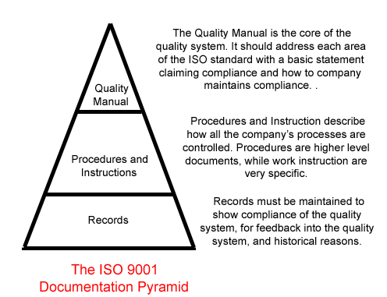

Slide 51
QMS Documentation
Document Numbering System
How can we develop a code?
HRD / 02 / 05
HRD – Human Resources Department
02 - Type of Document – SOP, therefore level 2
  05 - Procedure Number 5, example Recruitment Procedure

Slide 52
Example of a document code for a Quality Manual:
QM/01/01
Example of a document code for a Store Procedure / SOP:
STR/02/01
Example of a document code for a Store Daily Inventory Record:
STR/03/001

Slide 53
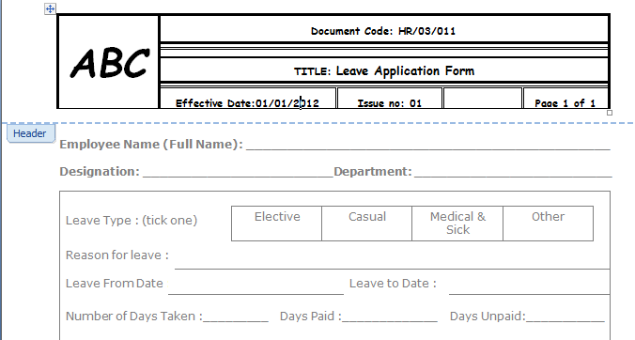

Slide 54
Records to be maintained as per ISO 9001: 2008
5.6.1 General (Management Review)
6.2.2 Competence, Training & Awareness
7.1 Planning of Product Realization
7.2.2 Review of Records. Rel. to the product
7.3.2 Design & Development (D&D) Inputs
7.3.4 D & D Review
7.3.5 D & D Verification
7.3.6 D & D Validation
7.3.7 Control D & D Changes
7.4.1 Purchasing Process

Slide 55
Records to be maintained as per ISO 9001: 2008
XI. 7.5.2 Validation of processes for prod & Svc Provision
XII. 7.5.3 Identification & Traceability
XIII. 7.5.4 Customer Property
XIV. 7.6 Control Of M & M Equipment (Basis for Cali)
XV. 7.6 Control Of M & M Equipment (Calibration)
XVI. 8.2.2 Internal Audit
XVII. 8.2.4 Monitoring & Measurement (M&M) of Product
XVIII . 8.3 Control Of Nonconforming Product
8.5.2 Corrective Action
8.5.3 Preventive Action

Slide 56
Contents of ISO 9001:2008
CLAUSES |  |  | TOPICS | PAGE
1 |  |  | Scope | 01
2 |  |  | Normative references | 01
3 |  |  | Terms and definitions | 01
4 |  |  | Quality Management System (QMS) | 02
5 |  |  | Management responsibility | 03
6 |  |  | Resource management | 06
7 |  |  | Product realization | 07
8 |  |  | Measurement, analysis and improvement | 12 - 13
Annex A |  |  | Correspondence between ISO 9001:2008 and ISO 14001:2004
Annex B |  |  | Changes between ISO 9001:2000 and ISO 9001:2008
Bibliography

Slide 57
5.0 Management Responsibility
5.1 Management commitment
Top management shall provide evidence of its commitment to the development and implementation of the quality management system and continually improve its effectiveness by
Communicating to the organization the importance of meeting customer as well as statutory and regulatory requirements;
Establishing the quality policy;
Ensuring that quality objectives are established;
Conducting management reviews; and
Ensuring the availability of resources.

Slide 58

5.2 Customer focus:
Top management must ensure that customer needs and expectations:
Determine and fulfillment
Enhancing customer satisfaction
Notes:
7.2.1 & 8.2.1, p1

Slide 59
5.3 Quality policy:
Top management shall ensure that the quality policy
is appropriate to the purpose of the organization,
includes a commitment to comply with requirements and continually improve the effectiveness of the QMS
provides a framework for establishing and reviewing quality objectives,
is communicated and understood within the organization, and
is reviewed for continuing suitability.

Slide 60
Sample Quality Policy
The goal of ABC Furniture Ltd. is to become a highly reputed Furniture manufacturer in the National & Global market by producing standard and quality products.
We have been inspired from our customer and their choices to make complete authentic furniture by believing in Customer Satisfaction first!
To meet this goal, ABC Furniture Ltd has adopted the Quality Management System (QMS) & complies with all applicable law/s.
We have a group of experienced designers and technicians to create the best product for our valued customers. All our products are designed differently and go through strict quality control after production. We use selected raw materials such as 100% seasoned and treated natural wood, the best quality MDF Boards, Hardware, Accessories and world famous lacquer items.
We always aim at offering unique designs tagged with competitive price and after sales service for our valued customers’ trust and faith enabling everyone to enjoy life thoroughly through our products.
Performance / policy will be reviewed as and when required and all areas will be continually improved to achieve the goal of the organization.

Slide 61
5.4 Planning
5.4.1 Quality objectives
Quality Objectives
To be established at relevant functions and levels
Must be measurable and consistent with the quality policy
Shall include those needed to meet product requirements

Slide 62
SMART OBJECTIVES
SPECIFIC: clear statement of what needs to be achieved
MEASURABLE: success can be objectively validated
ACHIEVABLE: can be done, we have the resources
REALISTIC: can be done given any constraints that might apply
TIMEBOUND : has a clear target date for achievement

Slide 63
5.4.2 Quality management system planning:
Top management shall ensure that:
The planning of the system is carried out in order to meet the requirements (clause refer to 4.1)
The integrity of the system is maintained when changes to system are planned and implemented
ISO 9001:2008

Slide 64

5.5 Responsibility, authority and communication:
5.5.1 Responsibility and authority
Top management shall ensure that the responsibilities, authorities and their interrelation are defined
ISO 9001:2000 Awareness

Slide 65
5.5.2 Management representative:
Top management shall appoint a member of the organization’s management who, irrespective of other responsibilities, shall have responsibility and authority to
Ensuring the processes are established, implemented and maintained
Promoting awareness of customer requirements through out the organization
Reporting on performance of the system and the needs for improvement
Liaison with external parties
ISO 9001:2000 Awareness

Slide 66

5.5.3 Internal Communication:
The organization shall ensure communication between its various levels and functions regarding the processes of the quality management system and their effectiveness
Notes:
Refer to clause 5.1

Slide 67

5.6 Management review:
5.6.1 General
Top management shall review the organization’s quality management system at planned interval
Ensure its continuing suitability, adequacy and effectiveness
Include assessing, opportunities for improvement and the need for changes to the system
Quality Policy and Quality Objectives
Maintain Records

Slide 68
5.6.2 Review input:
Inputs to the review to include current performance and improvement opportunities related to the following
Results of audits
Customer feedback
Process performance and product performance
Status of preventive and corrective actions
Follow-up actions from earlier reviews
Changes that could affect the QMS
Recommendations for improvement

Slide 69
5.6.3 Review output:
The outputs from the review shall include
Improvements of the quality management system
Improvement of product related to customer requirements
Resource needs

Slide 70
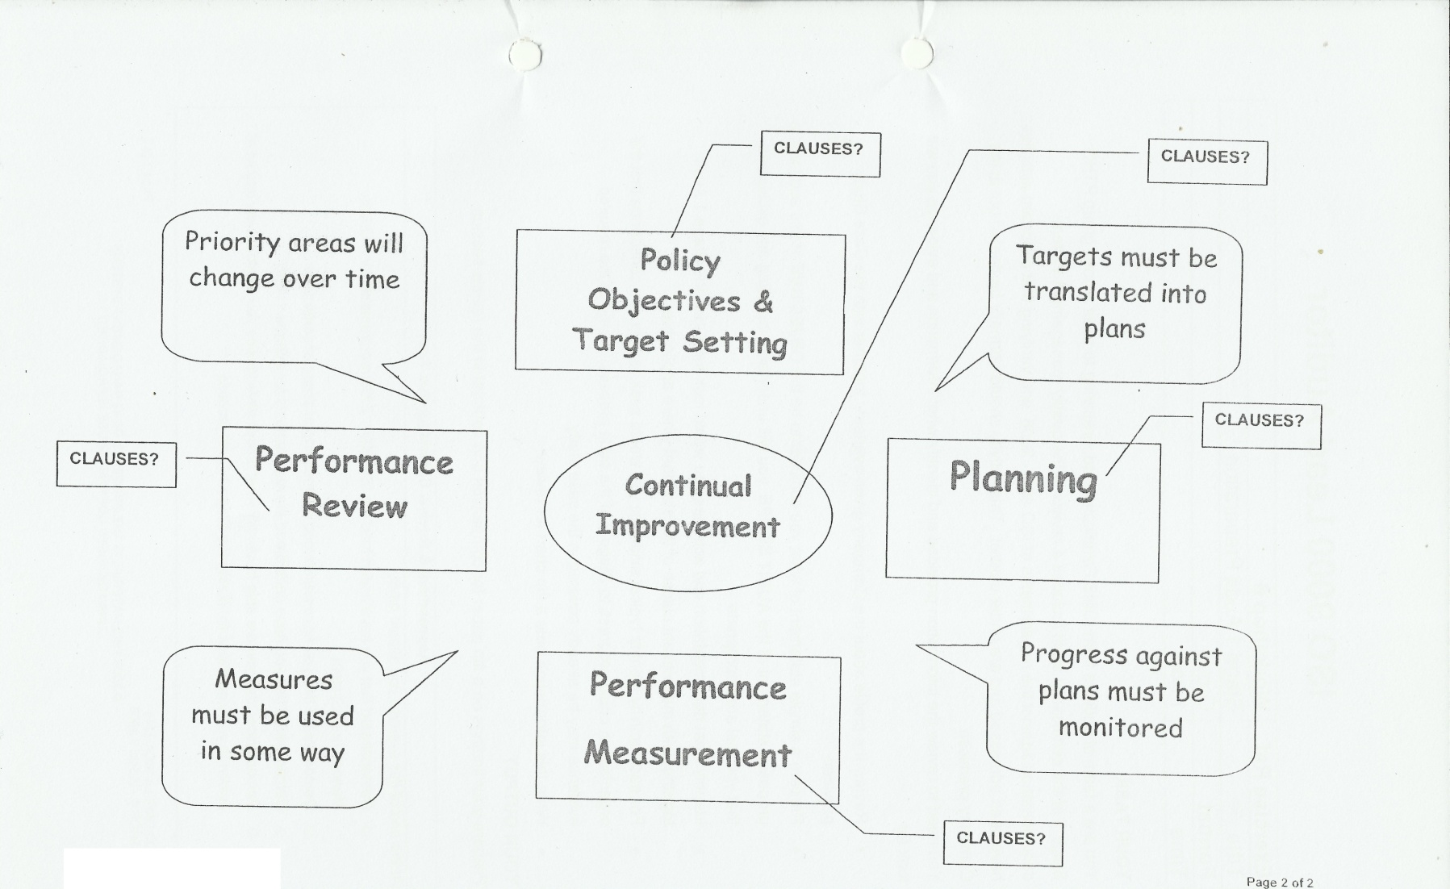
11. Workshops / Exercises
Find out the appropriate clauses in the continual improvement

Slide 71
Contents of ISO 9001:2008
CLAUSES |  |  | TOPICS | PAGE
1 |  |  | Scope | 01
2 |  |  | Normative references | 01
3 |  |  | Terms and definitions | 01
4 |  |  | Quality Management System (QMS) | 02
5 |  |  | Management responsibility | 03
6 |  |  | Resource management | 06
7 |  |  | Product realization | 07
8 |  |  | Measurement, analysis and improvement | 12 - 13
Annex A |  |  | Correspondence between ISO 9001:2008 and ISO 14001:2004
Annex B |  |  | Changes between ISO 9001:2000 and ISO 9001:2008
Bibliography

Slide 72
6.1 Provision of resources:
The organization shall determine and provide the resources needed to
Implement and maintain the quality management system and continually improve its effectiveness; and
Enhance customer satisfaction by meeting customer requirements.
This is to be done in a timely manner

Slide 73

6.2 Human resources:
6.2.1 General:
Personnel performing work affecting conformity to product requirements shall be competent on the basis of
Applicable education
Training
Skills
Experience

Slide 74
6.2.2 Competencies, awareness and training:
The organization shall:
Determine the necessary competence for personnel performing work affecting conformity to product requirements.
Where applicable, provide training or take other actions to achieve the necessary competence
Ensure than the necessary competence has been achieved
Ensure that employees are aware of the relevance and importance of their activities and how they contribute to the achievement of Quality Objectives
Maintain records

Slide 75
6.3 Infrastructure
Infrastructure needed to achieve product conformity shall be identified, provided and maintained, including:
Building, workspace and associated facilities
Process equipment (both hardware and software), and
Supporting services (such as transport, communication or information systems)

Slide 76

6.4 Work Environment
The organization shall determine and manage the work environment needed to achieve conformity to product requirements
The term work environment relates to conditions necessary to achieve conformity to product requirements such as clean rooms, noise, temperature, humidity, lighting or weather.

Slide 77
Contents of ISO 9001:2008
CLAUSES |  |  | TOPICS | PAGE
1 |  |  | Scope | 01
2 |  |  | Normative references | 01
3 |  |  | Terms and definitions | 01
4 |  |  | Quality Management System (QMS) | 02
5 |  |  | Management responsibility | 03
6 |  |  | Resource management | 06
7 |  |  | Product realization | 07
8 |  |  | Measurement, analysis and improvement | 12 - 13
Annex A |  |  | Correspondence between ISO 9001:2008 and ISO 14001:2004
Annex B |  |  | Changes between ISO 9001:2000 and ISO 9001:2008
Bibliography

Slide 78
7 Product realization
7.1 Planning of product realization
The organization shall plan and develop the processes needed for product realization
Consistent with the other requirements
Quality objectives and requirements
The need to establish processes, documentation and provide resources specific to the product
Verification, validation, monitoring, measurement, inspection and test and its criteria
Necessary records
Notes:
Product realization is that sequence of processes and sub-processes required to achieve the product.

Slide 79
7.2 Customer related processes
7.2.1 Determination of requirements related
Customer requirements shall be determine including:
Product requirements specified by the customer including delivery and pot deliver activities
Requirements not stated by the customer but necessary for specified or intended use where known
Statutory and regulatory requirements applicable to the product and
Additional requirements as needed by the organization
Notes:
Post deliver activities may includes actions under warranty provisions, contractual obligations such as maintenance services and supplementary services such as recycling or final disposal.

Slide 80
7.2.2 Review of requirements related to the product
Prior committing to supply product, the organization shall review
Product requirements
Resolution of differences
Ability to meet defined requirements
The results of the review shall be recorded
Where product requirements are changed, the relevant documentation shall be amended
Relevant personnel shall be made aware of the changed requirements
Notes:
Examples from alexey

Slide 81
7.2.3 Customer communication
Arrangements for communication to customers shall be identified and implemented
These to include:
Product information
Enquiries, contracts or order handling, and amendments
Customer feedback, including customer complaints

Slide 82
7.3 Design and development
7.3.1 Design and development planning
The design and development planning, the organization shall determine
The design and development stages
The review, verification and validation that are appropriate to each design and development stage
The responsibilities and authorities for design and development
The interfaces between different groups involved in design and development
Planning output shall be updated

Slide 83
7.3.2 Design and development inputs
Inputs shall include:
Functional and performance requirements
Statutory and regulatory requirements
Information derived from similar previous designs
Other requirements

Slide 84
7.3.3 Design and development outputs
The outputs of design and development shall be in a form suitable for verification against the design and development input and shall be approved prior to release,
Design and development output shall:
Meet the input requirements for design and development
Provide appropriate information for purchasing, production and services provision
Contain or reference product acceptance criteria
Specify the characteristics for the product that are essential for its safe and proper use
Notes:
Production and service provision includes preservation of products

Slide 85
7.3.4 Design and development review
Evaluate the ability to meet requirements
Identify problems and propose actions
Participants in such reviews shall include representative of functions concerned
records

Slide 86
7.3.5 Design and development verification
Ensure that the outputs have satisfied the input
records

Slide 87
7.3.6 Design and/or development validation
Ensure that the products is capable of fulfilling the requirements
Wherever practicable, validation to be completed prior to the delivery or implemented of the product
Records
Notes:
In other cases, performing design and development validation before introducing the new product is required by law; for example, in the case of introducing a new medicine.

Slide 88
7.3.7 Control of design and development changes
Changes shall be identified and records maintained
Review, verify and validate changes as appropriate
Evaluation of changes to include the effect of changes on constituent parts and delivered products
Records

Slide 89
7.4 Purchasing
7.4.1 Purchasing Process
Ensure that purchased product conforms to specified purchase requirements
The type and extent of control applied to the supplier
Evaluate and select suppliers based on their ability to meet requirements
Criteria for selection, evaluation and re-evaluation shall be established
Records

Slide 90
7.4.2 Purchasing information
Purchasing information shall describe:
Requirements for approval of product, procedures, processes and equipment
Requirements for qualification of personnel
Quality management system requirements

Slide 91
7.4.3 Verification of purchased product
Establish and implement the inspection or other activities necessary for ensuring that purchased product meets requirements
Include the verification at the supplier’s premises

Slide 92
7.5 Production and Service provision
7.5.1 Control of production and service provision
Plan and carry out production and service provision under controlled conditions, which includes:
Availability of information that describes the characteristics of the product
Availability of work instruction as necessary
Equipment
Monitoring and Measuring Equipment
Product release, delivery and post-delivery activities.

Slide 93
7.5.2 Validation of processes for production and service provision
Where the resulting output cannot be verified by subsequent monitoring or measurement.
Validation shall demonstrate the ability of these processes to achieve planned results
Defined criteria for review and approval
Approval for equipment and qualification of personnel
Use of specific methods and procedures
Records
Re-validation
Notes:
7.51 only where 7.5.2 NA

Slide 94

7.5.3 Identification and traceability
Identify the product by suitable means throughout product realization
Identify the product status with respect to monitoring and measurements requirement
Control the unique identification of the product traceability purpose
When and What ………

Slide 95
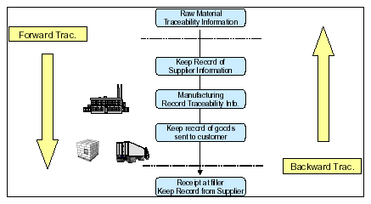
Example of Up stream and Down Stream Traceability Concepts
Notes:
Up stream is forward and Down stream is backward

Slide 96
7.5.4 Customer property
Identify, verify, protect and safeguard customer property
If any customer property found to be unsuitable for use, this shall be reported to the customer and maintain records
Include intellectual property

Slide 97
7.5.5 Preservation of product
Preserve the product during internal processing and delivery to the intended destination in order to maintain conformity to requirement.
As applicable preservation shall
Include identification, handling, packaging, storage and protection

Slide 98
7.6 Control of Measuring and Monitoring equipments
The organization shall determine:
Measurements that need to be made and
Monitoring devices required to assure conformity of product to specified requirements
Monitoring devices to be used and collected to ensure that measurement capability is consistent with measurement requirements.
Monitoring devices, where applicable shall be:
Calibrated and adjusted periodically or prior to use
Traceable to international or national standard
Identification to enable their calibrations status
Safeguarded from invalid adjustments
Notes:
Process equipment under 6.3, product conformity 7.6

Slide 99
7.6 Control of monitoring and measuring equipment
Protected from damage and deterioration
Take action when the equipment is found not to conform to requirements
Results recorded

Slide 100
Contents of ISO 9001:2008
CLAUSES |  |  | TOPICS | PAGE
1 |  |  | Scope | 01
2 |  |  | Normative references | 01
3 |  |  | Terms and definitions | 01
4 |  |  | Quality Management System (QMS) | 02
5 |  |  | Management responsibility | 03
6 |  |  | Resource management | 06
7 |  |  | Product realization | 07
8 |  |  | Measurement, analysis and improvement | 12 - 13
Annex A |  |  | Correspondence between ISO 9001:2008 and ISO 14001:2004
Annex B |  |  | Changes between ISO 9001:2000 and ISO 9001:2008
Bibliography

Slide 101
8 Measurement, analysis and improvement
8.1 General
Plan and implement the monitoring, measurement, analysis and improvement processes needed to
Demonstrate conformity of the product
Ensure conformity of the quality management system
Continually improve the effectiveness of system
Determination of applicable methods, including statistical techniques

Slide 102
8.2 Monitoring and measurement
8.2.1 Customer Satisfaction
Monitor information relating to customer perception
Methods for obtaining and using this information shall be determined by ways like:
Customer Satisfaction Surveys
Customer data on delivered product quality
User opinion surveys
Lost business analysis
Compliments
Warranty claims etc

Slide 103
8.2 Monitoring and measurement
8.2.2 Internal Audit
Conduct internal audits at planned intervals to determine that the QMS
Conforms to the planned arrangements and to the quality management system requirements
Effectively implemented and maintained
Programme shall be planned, taking into consideration the status and importance of the processes and the results of previous audits
The responsibilities and requirements for planning and conducting audits, and for reporting results and maintaining records shall be defined in a documented procedure
Corrections and corrective actions without undue delay.

Slide 104
8.2 Monitoring and measurement
8.2.3 Monitoring and measurement process
Apply suitable methods for monitoring and measurement of the processes
Demonstrate the ability of the processes to achieve planned results
When results are not achieved, correction and prevention action shall be taken

Slide 105
8.2 Monitoring and measurement
8.2.4 Monitoring and measurement of product
Monitor and measure the characteristics of the product to verify that product requirements are fulfilled
Evidence of conformity with acceptance criteria shall be maintained
The release of product and service delivery to the customer shall not proceed until the planned arrangements have been satisfactorily completed, unless otherwise approved by a relevant authority and where applicable by the customer

Slide 106
8.3 Control of nonconforming product
Ensure that non conforming products is identified and controlled to prevent its unintended use or delivery
Responsibilities and authorities for dealing with nonconforming product shall be defined in a documented procedure
Deal with nonconforming product by following:
Taking action to eliminate the detected nonconformity
Authorization its use, release or acceptance under concession
Taking action to prohibit its original intended use or application
If detected after delivery or use has started by taking action appropriate to the effects or potential effects of the NC
Records of the nature of nonconformities and any subsequent actions taken

Slide 107
8.4 Analysis of data
Appropriate data shall be collected and analyzed to determine:
customer satisfaction (see 8.2.1),
conformity to product requirements (see 8.2.4),
characteristics and trends of processes and products, including opportunities for preventive action
d) suppliers (see 7.4).

Slide 108
8.5 Improvement
8.5.1 Continual Improvement:
Continual improvement to be planned and managed by use of:
The quality policy
Objectives
Audits results
Analysis data
Corrective and preventive action
Management review

Slide 109
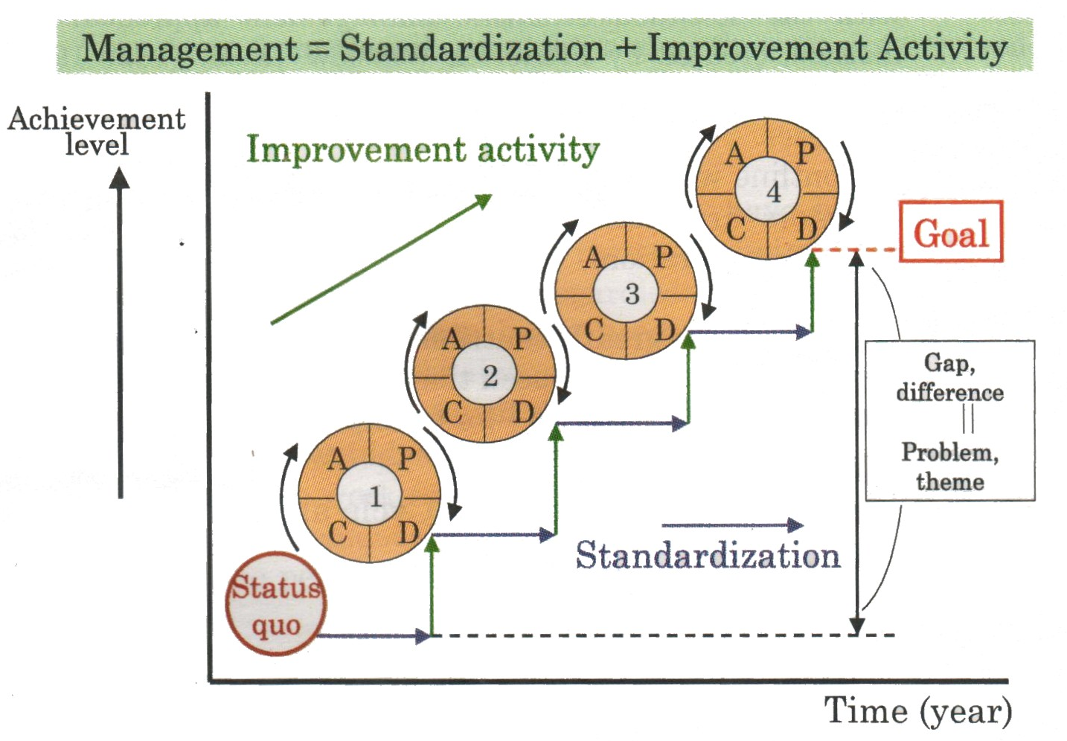

Slide 110
8.5 Improvement
8.5.2 Corrective action:
Take action to eliminate the cause of non conformities in order to prevent recurrence
Documented procedure shall be established to
Reviewing non conformities (including customer complaints)
Determining the cause of non conformities
Evaluating the need for action
Determining and implementing action needed
Records of the results of action taken
Reviewing corrective action taken

Slide 111
8.5 Improvement
8.5.3 Preventive action:
Determine action to eliminate the causes of potential non conformities in order to prevent their occurrence
Documented procedure shall be established to:
Determining potential non conformities and their cause
Evaluating the need for action need to prevent occurrence
Determining and implementing action needed
Records of the results of action taken
Reviewing corrective action taken

Slide 113
7. Conducting the audit
Conducting on-site activities
Intermediate & final wash-up meeting
With the local management and other managers
To review the audit findings
To discuss nonconformances
To agree corrective actions

Slide 114
7. Conducting the audit
Instructions for Closing Meeting
No Surprise
Don’t leave discussion on corrective actions for the closing meeting
Be diplomatic
Acknowledge achievement

Slide 115
7. Conducting the audit
Preparation for the Closing Meeting
Review audit findings
Prepare a list of findings
Reach consensus with team, if appropriate
Prepare a summary statement for the audit
Prepare recommendations, if required to (certification, inclusion on supplier list, etc…)
Discuss appropriate follow up action
This MUST be completed in time for the meeting

Slide 116

7. Conducting the audit
Closing meeting
Typical agenda:
Introduction and thanks
Reconfirm objectives, scope & criteria
Reconfirm the methods – inc. categories of findings
Sampling risk – no problems found does not mean non existence of NC
Reconfirm confidentiality agreement
Present and agree the findings – NC’s and Observations
Discuss corrective action plans and methods of close out and follow up
Get agree documented evidence like signatures etc
Timing for subsequent actions
Questions, recommendations, thanks & goodbye

Slide 117
7. Conducting the audit
Completion and follow-up
Follow-up action
At agreed time
Review of documentary evidence
Re-audit on the site
Only review of corrective action
Don’t start it all over again
Documentary evidence
Records
Training certificates
Amended procedures
Photographs
Videos

Slide 118
PHASES OF APPRAISAL
Day - 2
Introduction to Auditing
Terms and Definitions
Internal Audit Requirements
Principles of Auditing
Auditor’s role, responsibility and attitude
Audit Plan and Programme
Conducting the Audit
Follow up activities including evaluation of corrective action.
Certification Audit
Gap Analysis
Workshops / Exercises

Slide 119
8. Follow up activities including evaluation of corrective action.
The findings of the audit should be followed up, as required
Non-Conformities (NC / CAR) should be reviewed and closed out by
  Review documents submitted
  Review at next scheduled audit
  Special audit as per the instruction of the auditor

Slide 120
8. Follow up activities including evaluation of corrective action.
Before closing out an audit NC, the auditor should
Confirm that:
Corrective action has been carried out
  Has the auditee fully investigated the problem?
  Has any remedial action been taken?
  Has the root cause of the problem been addressed?
  Is the problem now less likely to re-occur?
Any preventive action is appropriate
  can others in the organisation benefit or learn from the audit findings?
  Has discussion taken place in management review meeting

Slide 121
PHASES OF APPRAISAL
Day - 2
Introduction to Auditing
Terms and Definitions
Internal Audit Requirements
Principles of Auditing
Auditor’s role, responsibility and attitude
Audit Plan and Programme
Conducting the Audit
Follow up activities including evaluation of corrective action.
Certification Audit
Gap Analysis
Workshops / Exercises

Slide 122
9. Certification Audit
Stage 1 audit – The purpose of this audit is essentially to assess the
organisation’s readiness for, and provide a focus for, the Stage 2 audit. It
should include :
  Checking system documentation to ensure that it satisfies ISO 9001 (e.g. clauses 4.2 .3, 4.2.4 etc ) – sometimes called a Document Review
  Evaluating the site – location - special requirements etc
  Holding discussions with appropriate site personnel to ‘break the ice’ and get a feel for the overall preparedness for stage 2
  Continued – next slide

Slide 123
9. Certification Audit
Stage 1 audit (continued) –
  Checking the clients’ understanding of the standard and process performance measurement
  Confirming the objectives and scope of the audit – and any legal requirements
  Assisting in allocating resources and agreeing details for stage 2
  Providing a focus for planning the stage 2 audit – especially for critical areas
  Checking implementation status for internal audit, document control, management review, process performance measurement and other system elements as appropriate

Slide 124
9. Certification Audit
The document review:
This is an important part of a Stage 1- however --
It is purely an assessment of system documentation
  To establish completeness of management system
  Policy statement, manual, procedures
  May be on site or off site
  Helps the auditor determine if the organisation is ready for an on site certification audit
  Helps the auditor develop the on site audit plan

Slide 125
9. Certification Audit
Stage 2 audit – the audit evaluates the implementation and effectiveness
of the organisation’s QMS. It will include checking:
  Conformity to all requirements of the quality management system
  Top management responsibility – policy, objectives, plans, MRM etc…
  Process performance measurement for meeting objectives and legal requirements
  Operational control of the processes
  The internal audit and management review meetig results
  Links between policy, objectives, quality plans, processes, resulting outcomes, performance measurement and action for all processes
  Continued - next slide

Slide 126
9. Certification Audit
Stage 2 audit (continued) –
If there are no significant problems, certification is recommended by the auditor to the CB (Certification Body)’s Rreview Panel
Panel reviews auditor’s recommendation and, if found satisfactory, it awards certification for 3 years – which is the recertification period.
Organisation is then subject to surveillance audits at intervals not more than 12 months (depending on size & complexity of organisation) and Recertification Audit every three year.

Slide 127
11. Workshops / Exercises
Group B: Find out the appropriate clauses in the continual improvement

Slide 128
11. Workshops / Exercises
Group C: Conducting an Opening meeting
Typical agenda:
Introduce team
Objectives, scope & criteria
Confidentiality
Timetable
Audit conduct – inc categories of findings
Sampling risk – no problems found does not mean that non exist
Facilities and arrangements
Confirm availability of people
Reporting and appeals system

Slide 129
11. Workshops / Exercises
Group D: Conducting an Closing meeting
Typical agenda:
Introduction and thanks
Reconfirm objectives, scope & criteria
Reconfirm the methods – inc. categories of findings
Sampling risk – no problems found does not mean non existence of NC
Reconfirm confidentiality agreement
Present and agree the findings – NC’s and Observations
Discuss corrective action plans and methods of close out and follow up
Get agree documented evidence like signatures etc
Timing for subsequent actions
Questions, recommendations, thanks & goodbye

Slide 130
Q&A and
Open Discussion

Slide 131
Course Evaluation

Slide 132
Thanks for your kind attention

